Slide 1
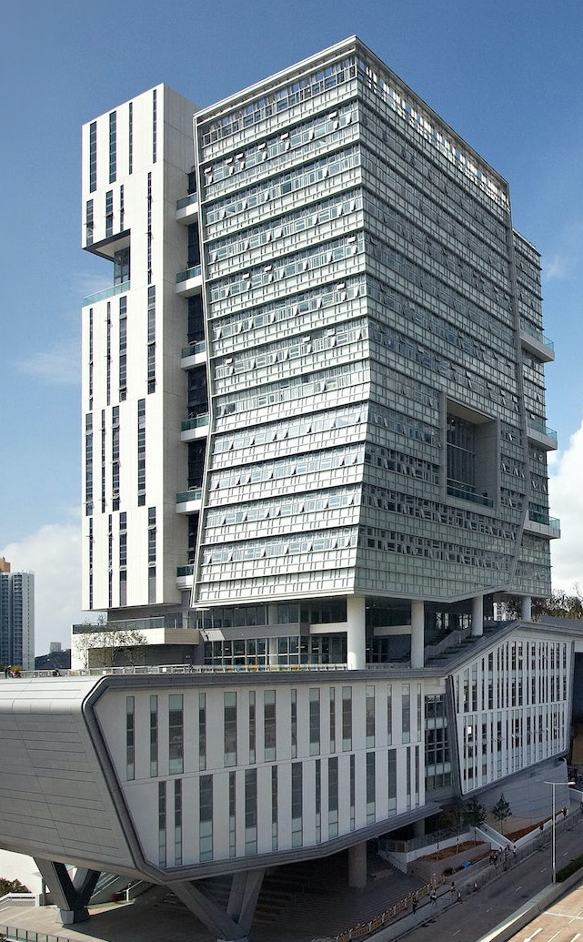

[CS5489] Group Project on Kaggle
[1]
LLM - Detect AI Generated Text
Date: 08/12/2023
Advisor: Prof Antoni Bert CHAN
Group 56
Members
[50%] YANG Yongze (5816 2210)
[50%] DUAN Suyang (5849 0066)
[1] Jules King, Perpetual Baffour, Scott Crossley, Ryan Holbrook, Maggie Demkin. (2023). LLM - Detect AI Generated Text. Kaggle. https://kaggle.com/competitions/llm-detect-ai-generated-text

Slide 2
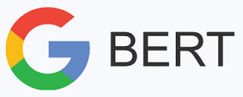






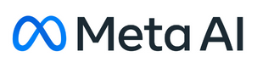
1 Introduction – Task of this Project
A classifier,
to detect
LLMs - [Plagiarism]
A Real Student
[Own Effort]
or
an essay
is written by
A Binary Classifier for Text(English) Data

Slide 3

1 Introduction – Overview of Our Work
0
Essay
Feature Extraction
N-Gram
Training Set (80%)
1
Essay
N-Gram
Dimensionality Reduction
Split
Validation Set
…
N-Gram
TF-IDF
0
Essay
N-Gram
TF-IDF
Dimensionality Reduction
Testing Set (20%)
0
Essay
Word Embedding (Word2Vec)
Original Dataset
Dataset Split
Feature Representation (Multiple Combinations)
Naïve Bayes
Grid Search
SVM
…
AUC
AUROC
Voting
Cross Validation
Main Indicator
XGBoost
Random Forest
Parameter Tuning
…
Radar Figure
Accuracy
F1 Score
Specificity
Bert+MLP
Acc
F1
Sensitivity
Precision
Sen
Other Indicators
Train Different Classifiers
with the best Parameters
Spe
Predict and Get Metrics
Pre
AUC

Slide 4
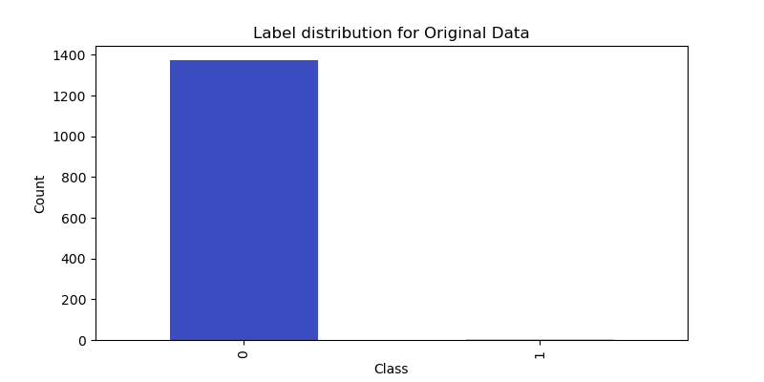
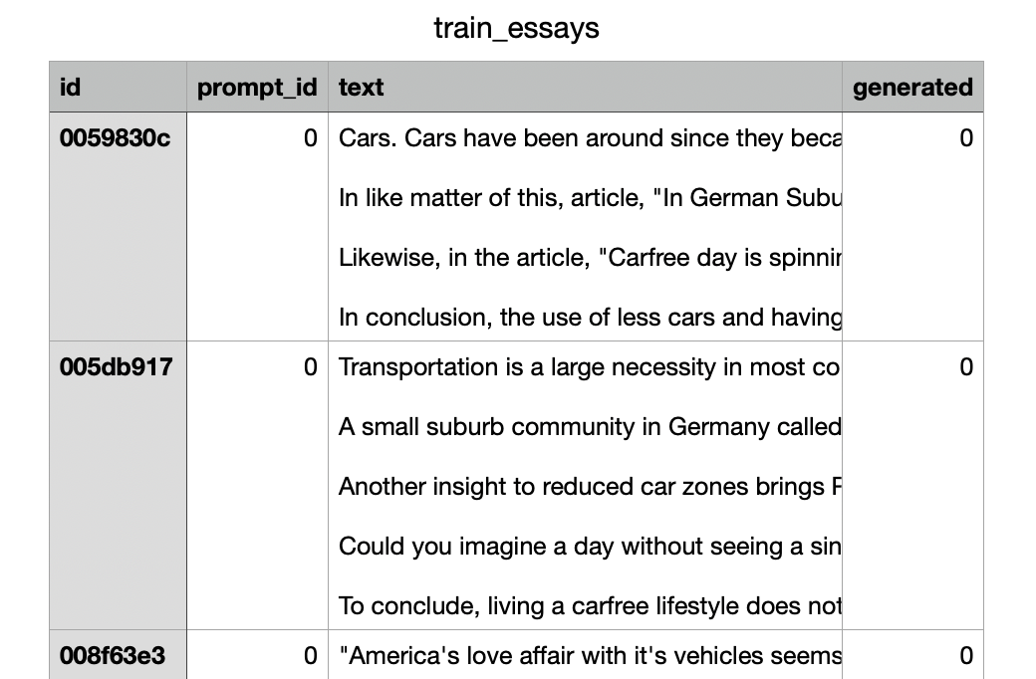
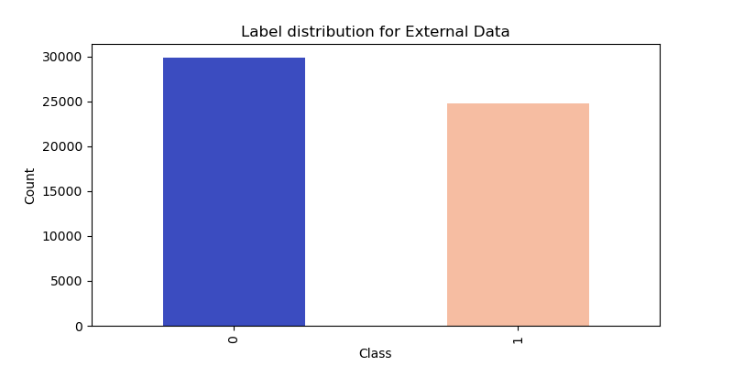
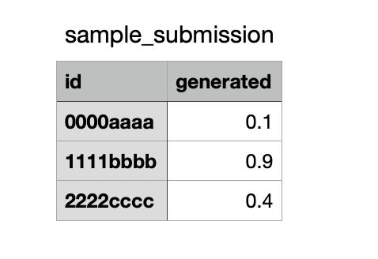
1 Introduction – Dataset and Kaggle Submission

Slide 5
2 Feature Representation – N-Gram, TF-IDF, Word2Vec
N-Gram
N-Gram
Dimensionality Reduction
N-Gram
TF-IDF
N-Gram
TF-IDF
Dimensionality Reduction
Word Embedding (Word2Vec)

Slide 6
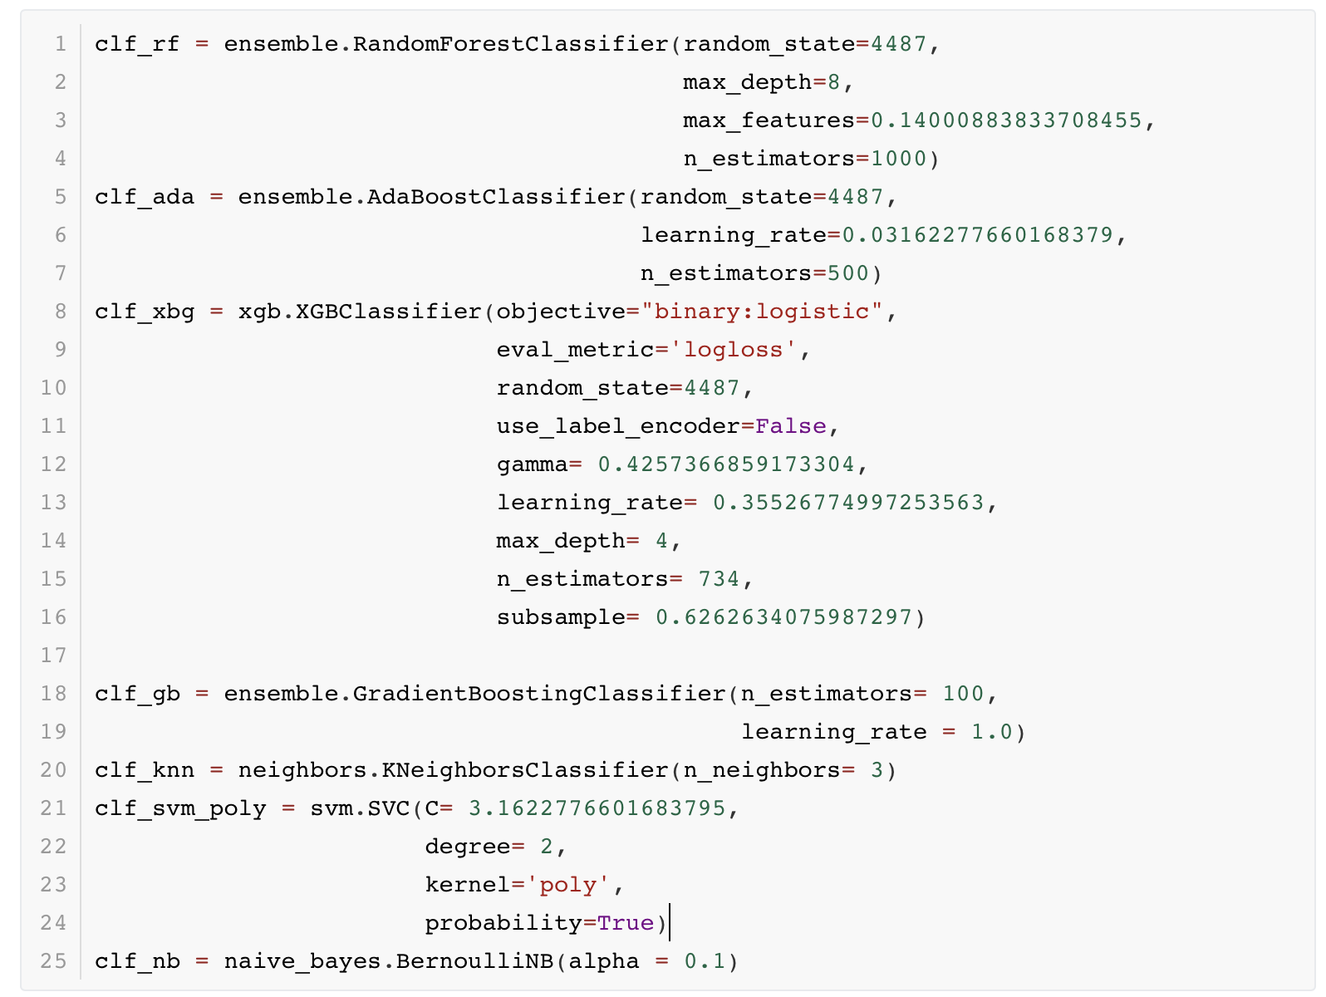
3 Classifier – SVM, AdaBoost, XGBoost, Random Forest, Gradient Boost, KNN, …

Slide 7
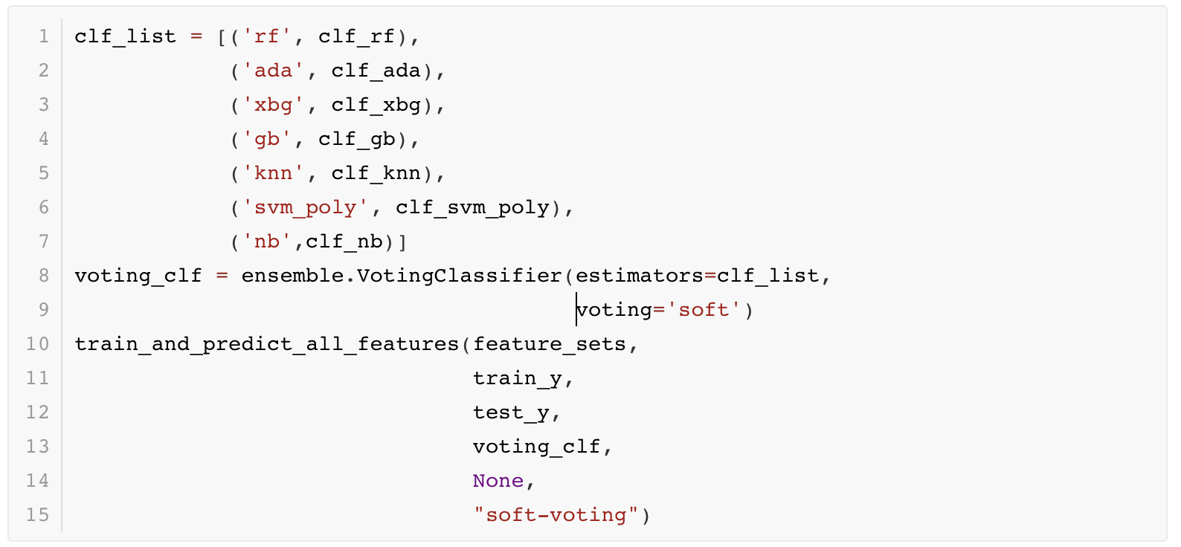
3 Classifier – Voting Classifier

Slide 8
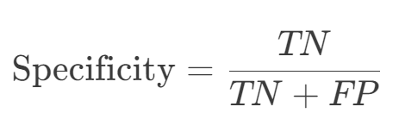
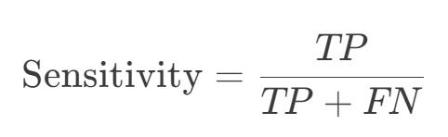
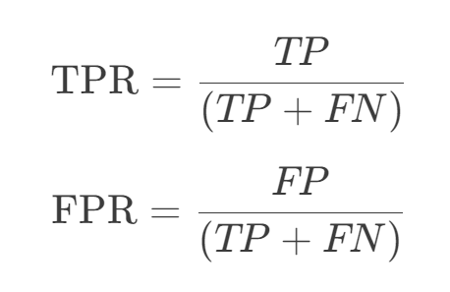
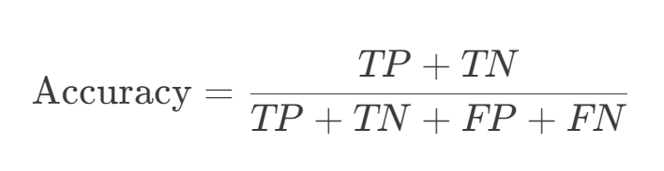
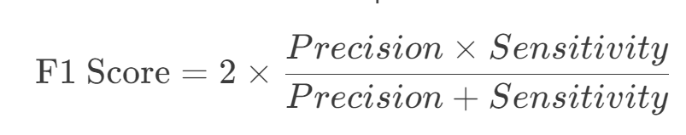
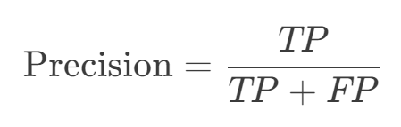
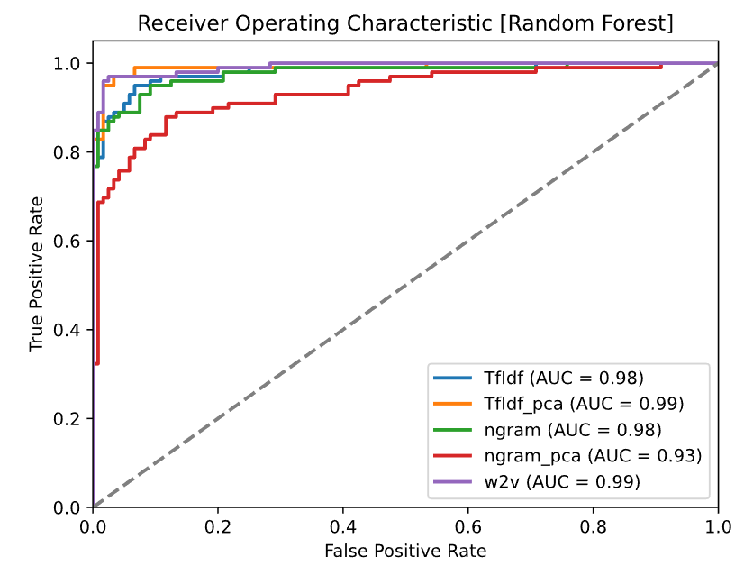
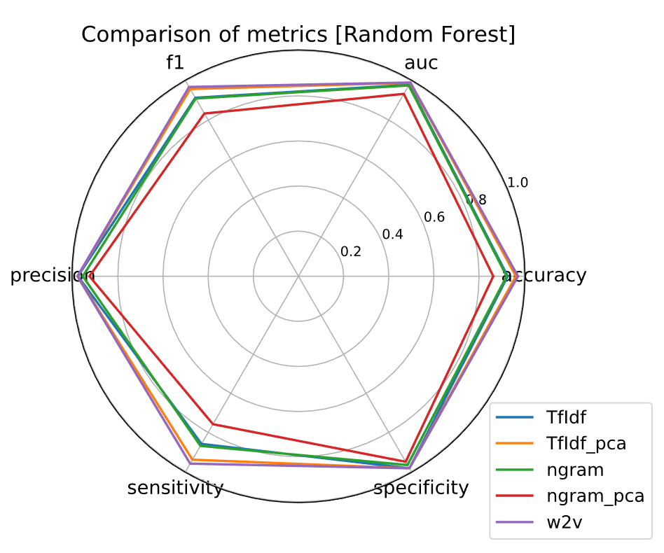
4 Results and Final Submission on Kaggle
Kaggle AUC: 0.77

Slide 9
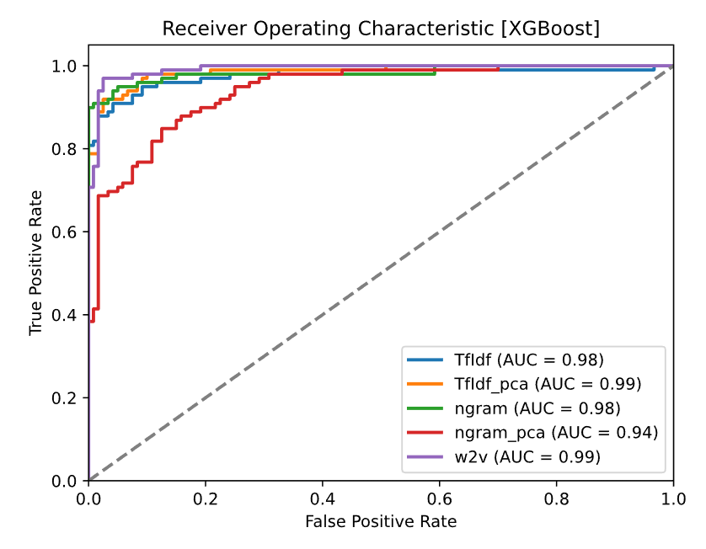
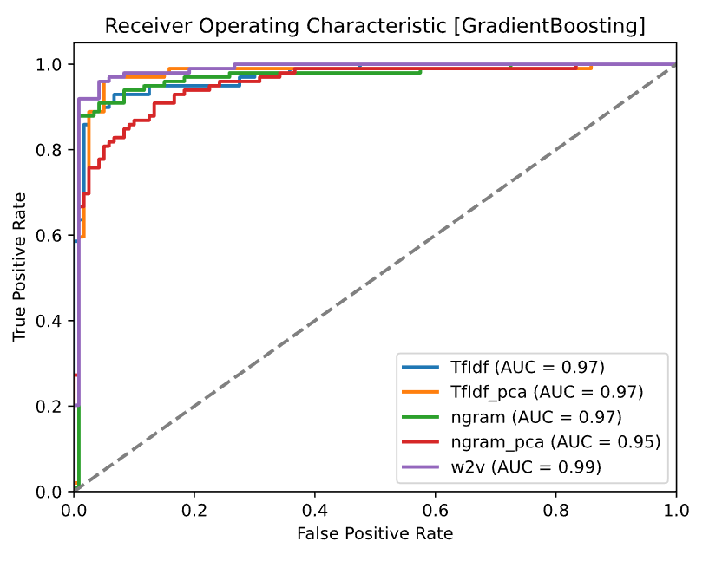
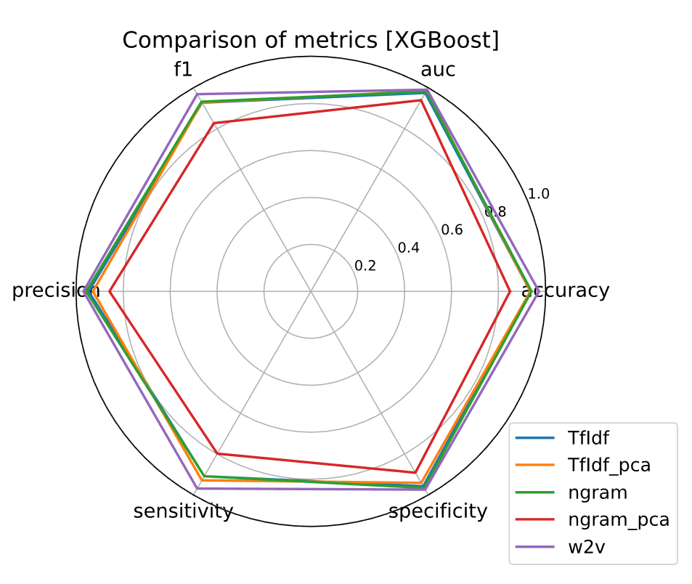
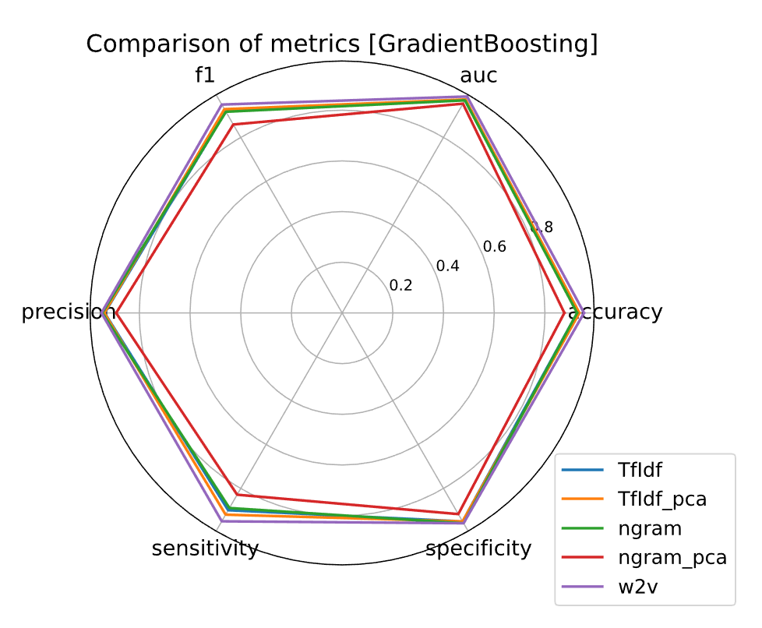
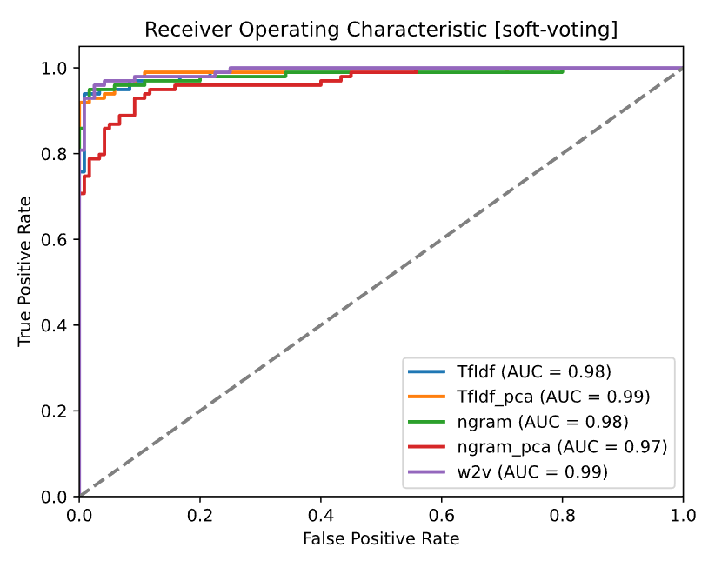
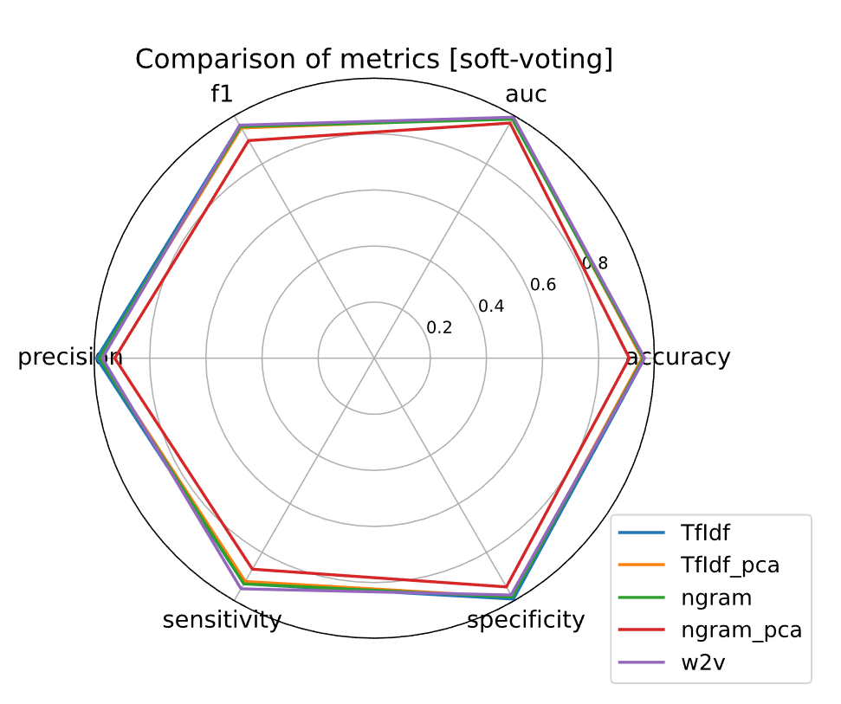
4 Results and Final Submission on Kaggle
Kaggle AUC: 0.77
Kaggle AUC: 0.75
Kaggle AUC: 0.81
Voting Classifier Has the Highest Kaggle AUC

Slide 10
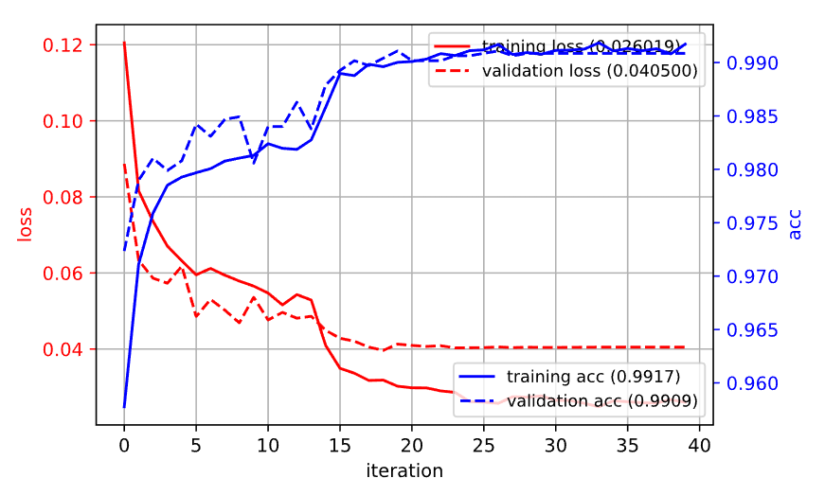
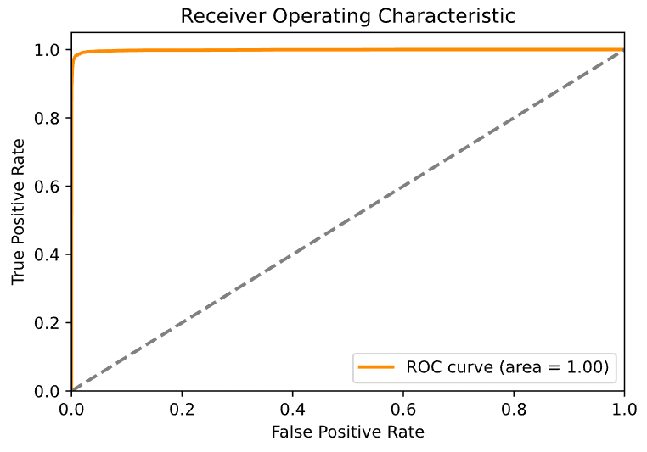
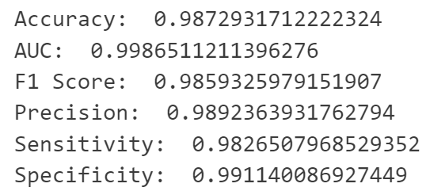
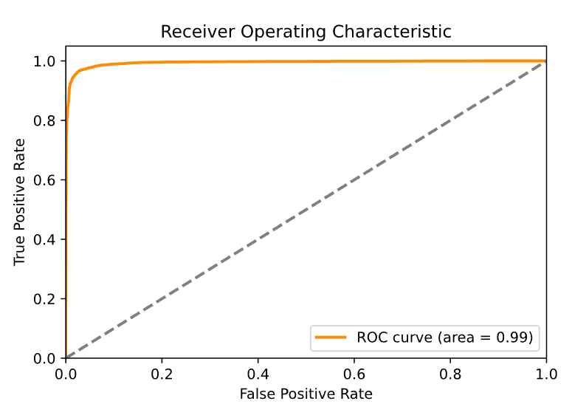
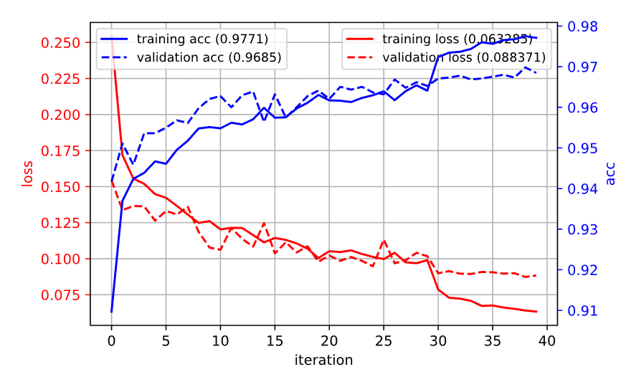
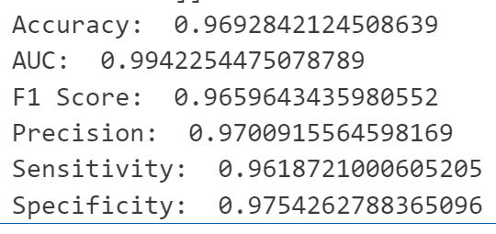
4 Results and Final Submission on Kaggle – MLP & BERT
Pure MLP
Kaggle AUC: 0.75
BERT + MLP
Kaggle AUC: 0.79

Slide 11
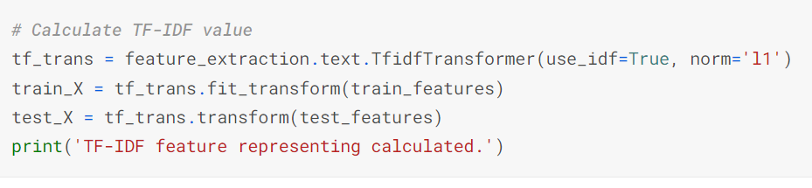

5 Our Final Submission
TF-IDF Representation
(Without Dimensionality Reduction)
Bernoulli Naïve Bayes
(With alpha = 1e-10)
Nothing new, not high AUC, ...
But is still the highest Kaggle AUC of ALL our attempts.

Slide 12

Thanks!
Please ask any questions
Advisor: Prof Antoni Bert CHAN
Group
Members
[50%] YANG Yongze (5816 2210)
[50%] DUAN Suyang (5849 0066)
Date: 08/12/2023

